Slide 1

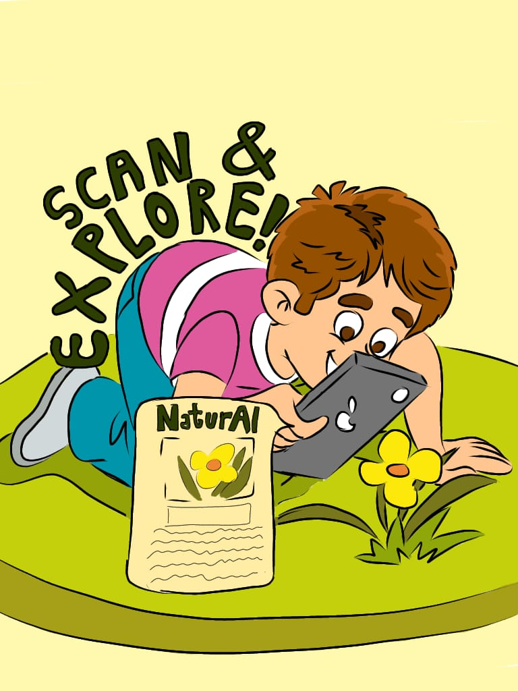
INDERPRASTHA ENGINEERING COLLEGE,GAZIABAD
TITLE OF PROJECT:-NATURAI
NAME OF STUDENTS:-KUNAL SAINI ,AYUSH PANDEY ,
HARSHITA SAJWAN,KARTIK BOHRA
DEPARTMENT OF APPLIED SCIENCES
session 2023-2024
INTRODUCTION
APPLICATIONS
.
Education: Enhancing botanical learning for students and nature enthusiasts.
Outdoor Exploration: Assisting hikers, campers, and nature lovers in identifying plants during outdoor activities.
Environmental Conservation: Supporting biodiversity monitoring and preservation efforts.
Health and Wellness: Offering herbal remedies and holistic health information.
Conclusion
The idea of using phone cameras to identify plants and provide comprehensive information, including Ayurvedic and traditional uses, holds great promise for education, environmental awareness, wellness, and more. By successfully developing and launching a user-friendly app with accurate data, continuous improvement, and community engagement, this initiative can empower individuals to connect with the natural world in meaningful ways while contributing to conservation and holistic wellness. The potential benefits for both users and the environment make this idea an exciting avenue for exploration and implementation.
Reference
Plantoscan:-https://plantophiles.com/plantoscan-ios/

